Slide 1
Data Structures And Algorithms

Slide 2
Recursion
The process in which a function calls itself directly or indirectly is called recursion
The corresponding function is called a recursive function.
A recursive function solves a particular problem by calling a copy of itself
Recursion has the ability of solving smaller subproblems of the original problems
Many more recursive calls can be generated as and when required.
It is essential to know that we should provide a certain case in order to terminate this recursion process
So we can say that every time the function calls itself with a simpler version of the original problem

Slide 3
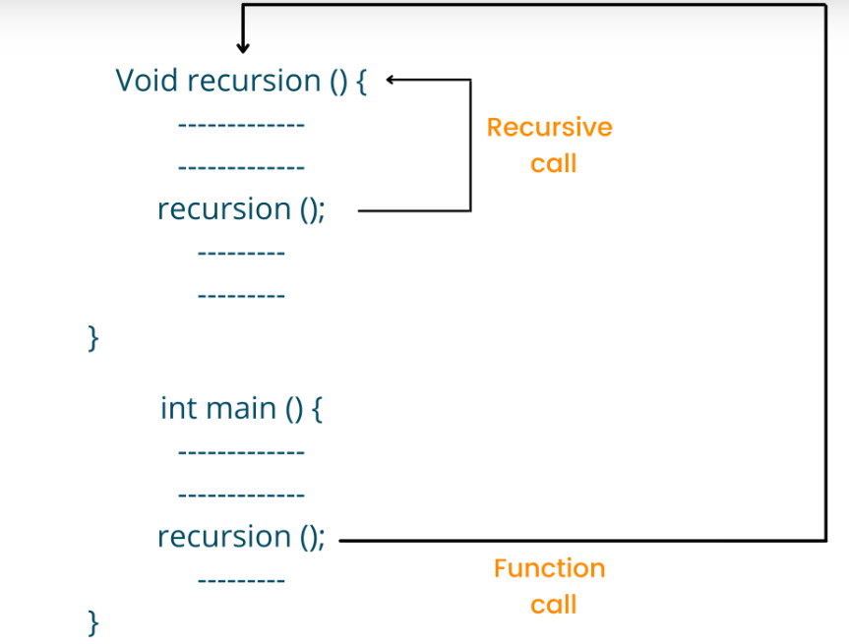
How recursion works?

Slide 4
Properties of recursion
Recursion is an amazing technique with the help of which we can reduce the length of our code and make it easier to read and write.
Performing the same operations multiple times with different inputs
In every step, we try smaller inputs to make the problem smaller
Base condition is needed to stop the recursion otherwise infinite loop will occur

Slide 5
Advantages of recursion
Less number code lines are used in the recursion program and hence the code looks shorter and cleaner.
Recursion is easy to approach to solve the problems involving data structure and algorithms like graph and tree
Recursion helps to reduce the time complexity
It helps to reduce unnecessary calling of the function
It helps to solve the stack evolutions and prefix, infix, postfix evaluation
Recursion is the best method to define objects that have repeated structural forms

Slide 6
Disadvantages of recursion
It consumes a lot of stack space
It takes more time to process the program
If an error is accrued in the program, it is difficult to debug the error in comparison to the iterative program.

Slide 7
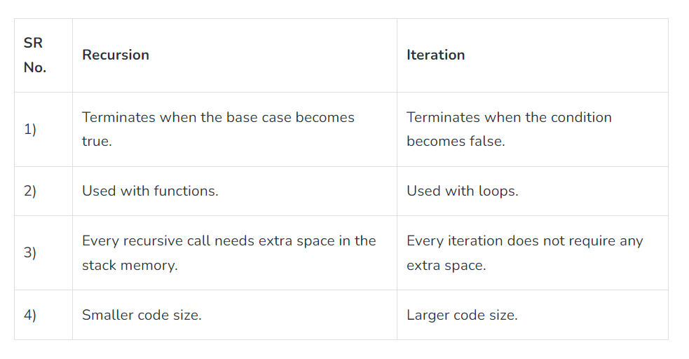
Recursion vs iteration

Slide 8
How recursive function are stored in memory?
Recursion uses more memory, because the recursive function adds to the stack with each recursive call
It keeps the values there until the call is finished
The recursive function uses LIFO (LAST IN FIRST OUT) Structure just like the stack data structure

Slide 9
Basics of recursion
There are two cases in the recursion/ recursive programs:
Base case
Recursive case
In the recursive program, the solution to the base case is provided
Base case terminates the recursive function
Solution to the bigger problem is expressed in terms of smaller problems

Slide 10
Factorial of a number
Iterative Approach
Recursive Approach
for(i=1; i<=number; i++)
fact=fact*i;
int fact(int n){
if(n > 1)
return n*fact(n-1);
else
return 1;
}

Slide 11
Sum of numbers from 1-5
Iterative Approach
Recursive Approach
int main()
{ int result = 0;
for(i=1; i<= 5; i++)
result = result + 1;
cout<<result; }
int sum(int k) { if (k > 0) { return k + sum(k - 1); } else { return 0; } } int main() { int result = sum(5); cout << result; return 0; }

Slide 12
